Slide 1
An overview of Rceattle
Grant Adams

Slide 2
Rceattle overview
Flexible code-base for single- and multi-species age structured modelling
Empirical weight-at-age (internal growth estimation in dev)
Species-, sex- and -age structured
Flexible in the number of species and fleets
Forecasting, simulation, and MSE capable

Slide 3
Background
Developed from Kirstin’s ADMB CEATTLE
Ported to TMB during my PhD
Code base and functionality developed to closely/exactly match CEATTLE (ADMB), GOA Pollock (ADMB/TMB), GOA ATF (ADMB), GOA Cod & Pacific Hake (Stock Synthesis)
Designed to fit different model formulations, include environmental indices/predation, and run MSEs

Slide 4
Key links
GitHub: https://github.com/grantdadams/Rceattle
On-boarding doc

Slide 5
Existing Rceattle applications
Pacific hake: 1 species (Sophia Wasserman)
GOA ATF SAFE model: 1 species (Kalei Shotwell and Grant Adams)
Hake + ATF: 2 species (Raquel Ruiz Diaz)
EBS CEATTLE: 3 species (Kirstin Holsman)
GOA CEATTLE: 4 species (Grant Adams)

Slide 6
Motivation and goals
Tool for “easily” fitting single- and multi-species model variants
Fit models with random effects
Easily assess model performance via diagnostics, fit metrics, simulation, and MSE
Help build environmentally-linked research models and MSE test SAFE models
Eye towards flexibility and documentation from PhD angst recreating custom/hard-coded models

Slide 7
Broad Rceattle workflow
Excel document to specify observation model:
Data (age/length composition, indices, catch)
Observation model specifications (q, selectivity, likelihood)
“Fixed” inputs (weight-at-age, M, maturity, sex ratio, transition matrix, ageing error)
R wrapper function fit_mod to specify and fit
Population dynamics specifications (M, initial conditions, recruitment, predation)
Forecast (HCR form, BRPs, recruitment)
Estimation controls

Slide 8
Broad Rceattle workflow
library(Rceattle) mydata <- read_data( file = "mydata.xlsx") # Reads in as list of data.frames mymodel <- fit_mod(data_list = mydata, inits = NULL, # Initial parameters at default estimateMode = 0, # Estimate random_rec = FALSE, # No random recruitment msmMode = 0, # Single species mode phase = TRUE, # Phase model verbose = 1) # Minimal messaging plot_biomass(mymodel)

Slide 9
Outputs
library(Rceattle) data("GOApollock") # 2018 Pollock model mymodel <- Rceattle::fit_mod(data_list = GOApollock, inits = NULL, # Initial parameters = 0 file = NULL, # Don't save estimateMode = 0, # Estimate random_rec = FALSE, # No random recruitment msmMode = 0, # Single species mode phase = TRUE, verbose = 1)
names(mymodel)
[1] "TMBfilename" "bounds" "map" "initial_params" [5] "phase_params" "estimated_params" "obj" "quantities" [9] "data_list" "run_time" "opt" "sdrep"

Slide 10
Basic excel data
meta_data: overview and description
control: species, year, age, length
fleet_control: observation model specification
index_data: survey or fishery indices (biomass/numbers)
catch_data: fishery catches
comp_data: age/length comp
weight: empirical weight-at-age (time-varying, fleet specific)
maturity: maturity-at-age (time-invariant)
sex_ratio: sex-ratio-at-age (time-invariant)

Slide 11
Selectivity specifications (fleet_control)
selectivity
0: empirical selectivity
1: logistic selectivity
2: non-parametric selecitivty (Ianelli)
3: double logistic
4: descending logistic
5: non-parametric selectivity (Taylor/Hake)
Time_varying_sel
0: no
1: random deviates
3: time blocks
4: random walk
5: random walk on ascending portion of double logistic only.

Slide 12
:::

Slide 13
Catchability specifications (fleet_control)
0 = Fixed
1 = Free parameter
2 = Free w/ normal prior
3 = Analytical
4 = Power equation
5 = $μ_{q}+X*β$
6 = sensu Rogers et al (2024)
Time_varying_q
0: no
1: random deviates
3: time blocks
4: random walk

Slide 14
Recruitment specifications
Mean recruitment, Beverton, Ricker
Env linkages to $mu$ or $α$
Priors on alpha or steepness
Ianelli penalty estimation
?build_srr # See options mymodel <- fit_mod( recFun = build_srr( srr_fun = 3, # Beverton proj_mean_rec = TRUE, srr_est_mode = 3, # Beta steepness prior srr_prior = 0.8, srr_prior_sd = 0.1, srr_indices = NA, # No environmental indices Bmsy_lim = NA), ... )

Slide 15
Mortality specifications
Input M-at-age
Fixed effects: species, sex, or age specific M
Random effects: AR1 or IID on year and/or age
Environmental linkages: $μ_{M}+X*β$
Lognormal prior
?build_M1 # See options mymodel <- fit_mod( M1Fun = build_M1( M1_model = 2, # Sex-specific M M1_re = 6, # 2D-AR1 on age/year M1_use_prior = FALSE, M_prior = 0.30, M_prior_sd = 0.05, M1_indices = NA), ... )

Slide 16
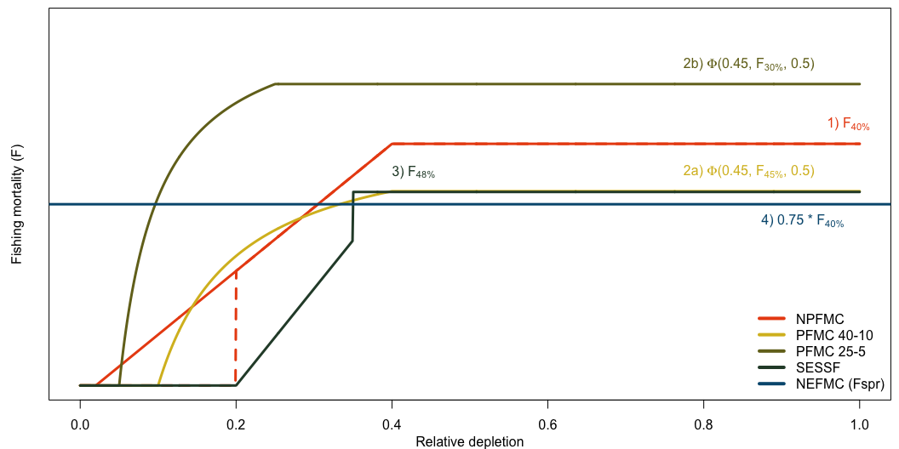
Harvest control rules
?build_hcr # See options mymodel <- fit_mod( HCR = build_hcr( HCR = 5, # Tier 3 HCR DynamicHCR = FALSE, # Equilibrium BRPs Ftarget = 0.40, # Target F-spr Flimit = 0.35, # Limit F-spr Ptarget = NA, Plimit = 0.2, # No F < 20% SB0 Alpha = 0.05, Pstar = NA, Sigma = NA, Fmult = NA, HCRorder = NA), ... )

Slide 17
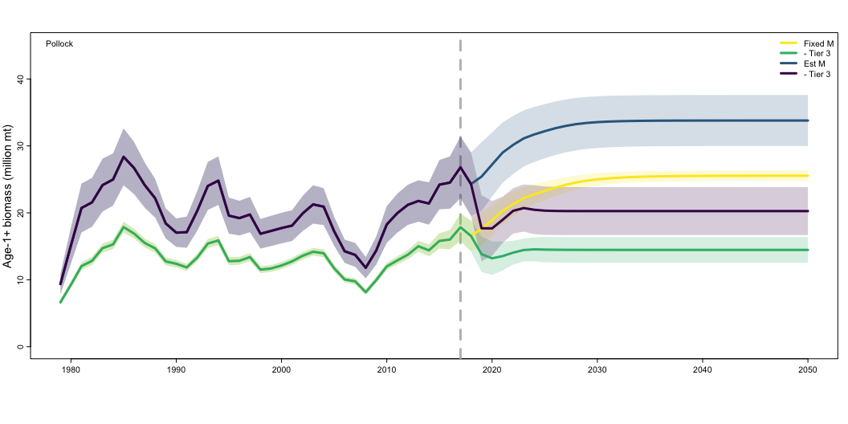
Time-series plotting
plot_biomass(mymodel) plot_recruitment(list(mymodel1, mymodel2)) plot_depletion() plot_depletionSSB() plot_mortality()

Slide 18
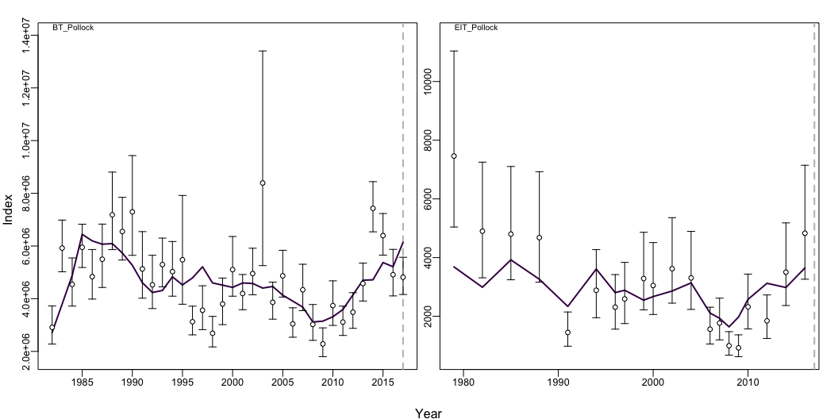
Diagnostics: ??Rceattle
plot_index(mymodel, species = 1)

Slide 19
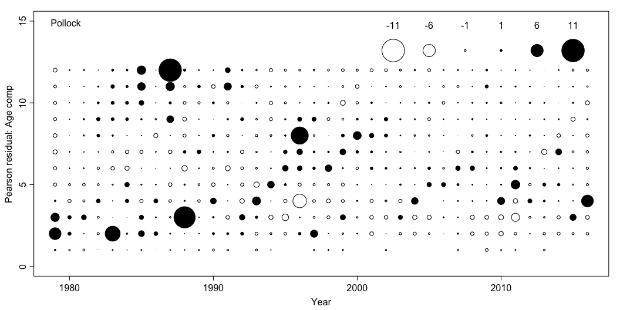
plot_comp(mymodel)

Slide 20
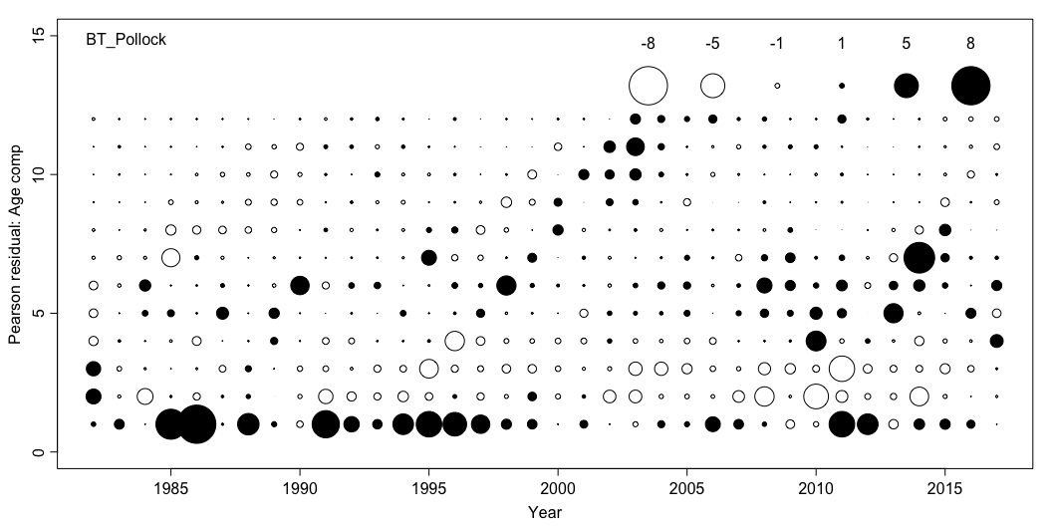

Slide 21
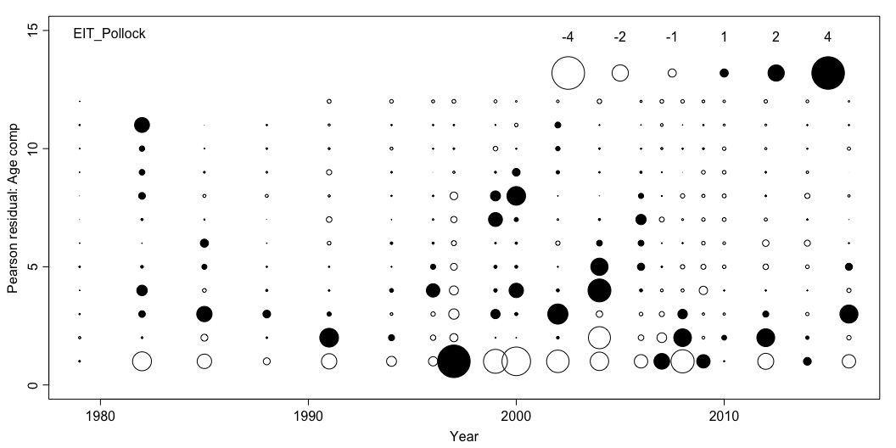

Slide 22
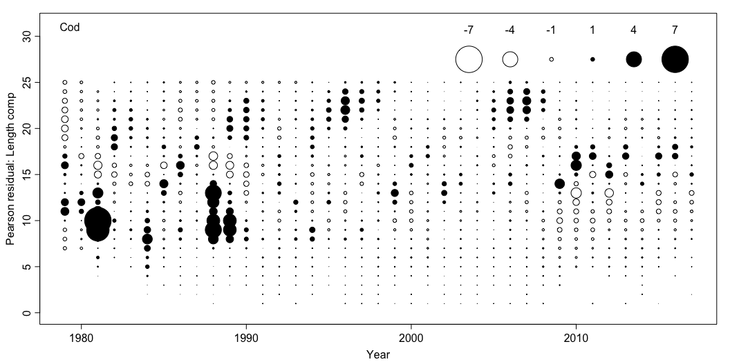

Slide 23
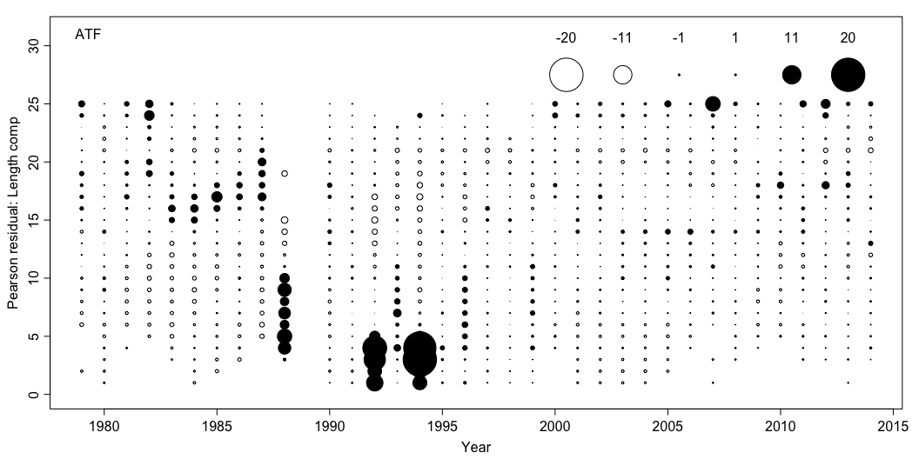

Slide 24
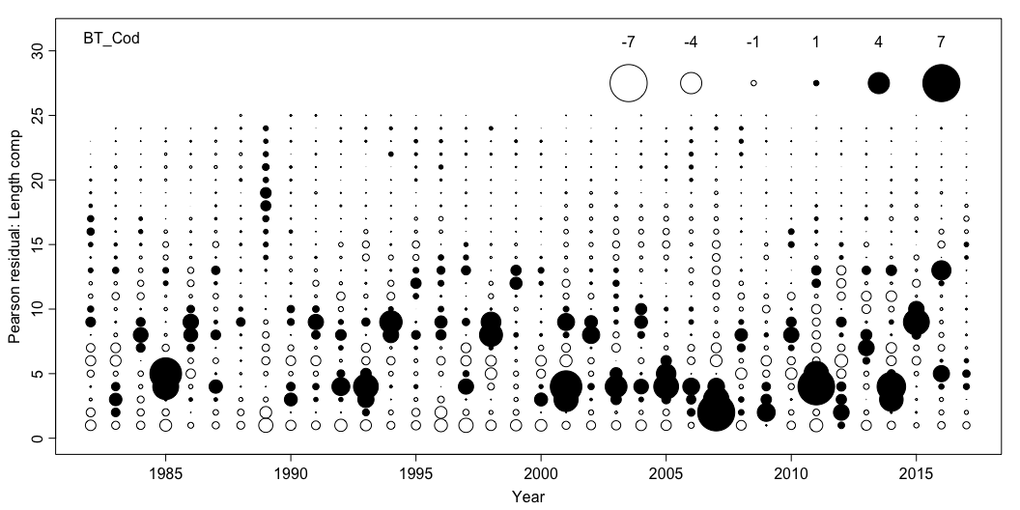

Slide 25
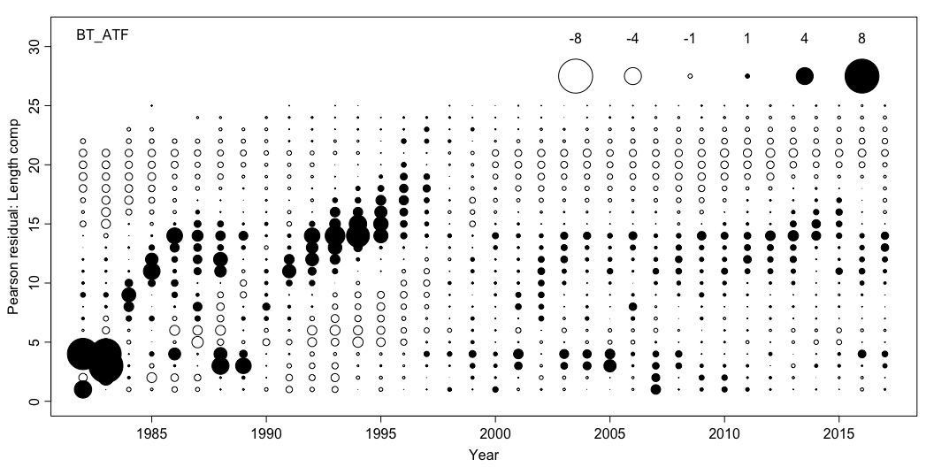

Slide 26
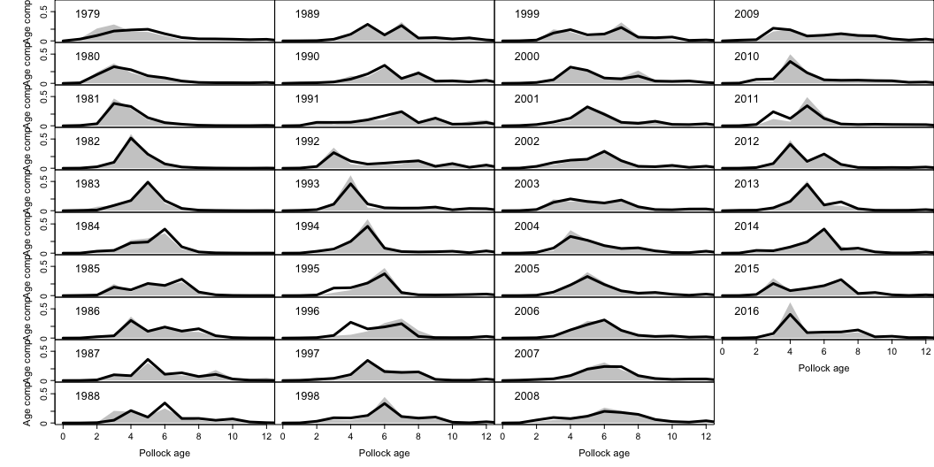

Slide 27
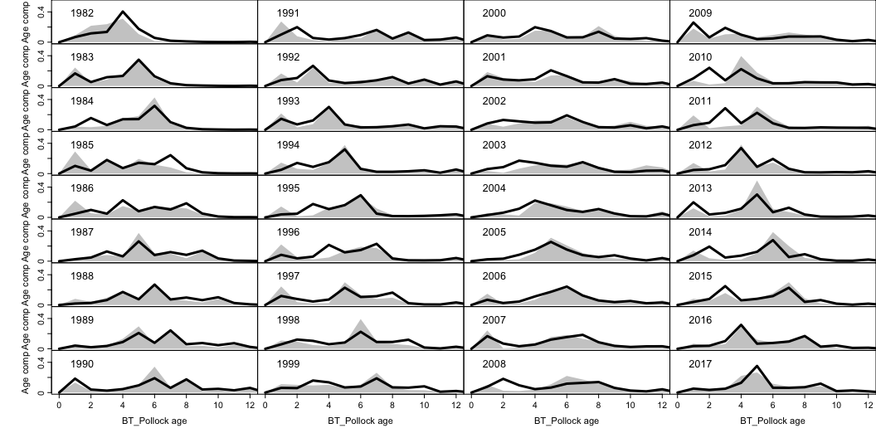

Slide 28
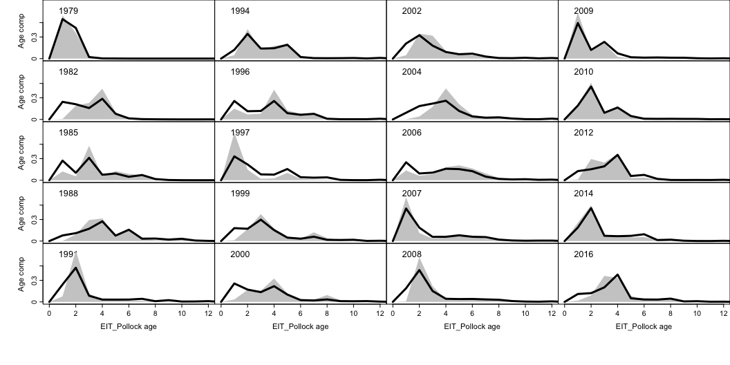

Slide 29
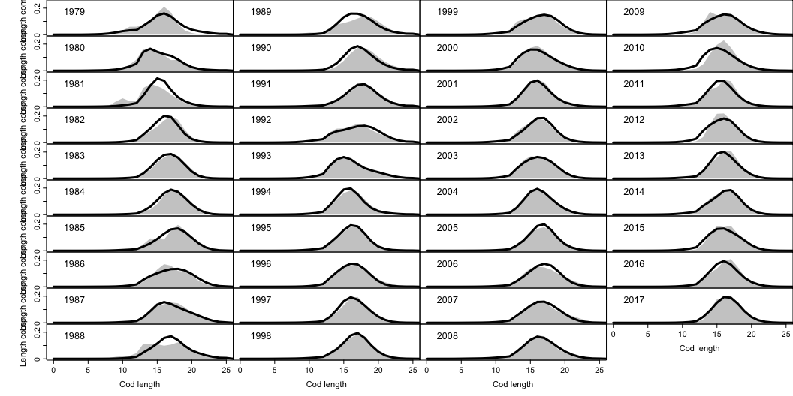

Slide 30
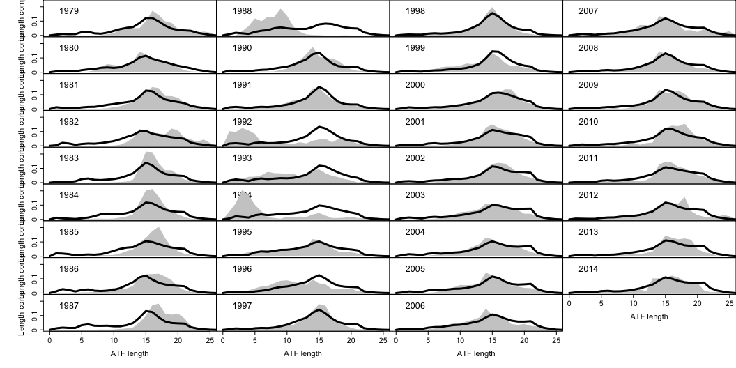

Slide 31
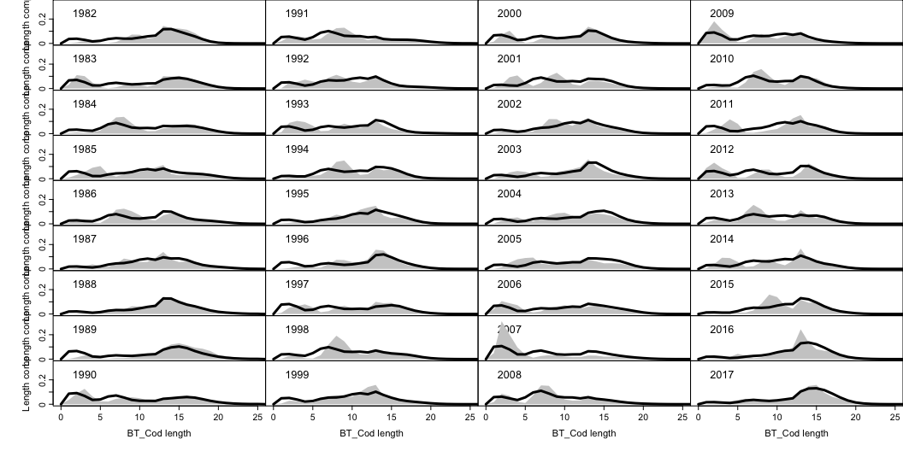

Slide 32
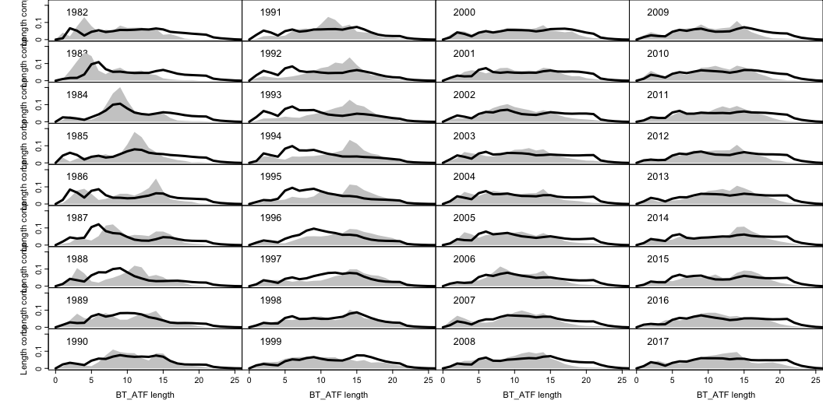

Slide 33
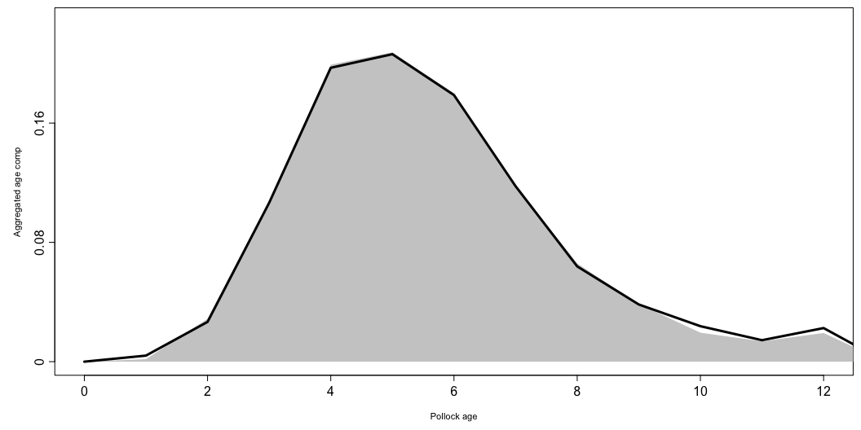

Slide 34
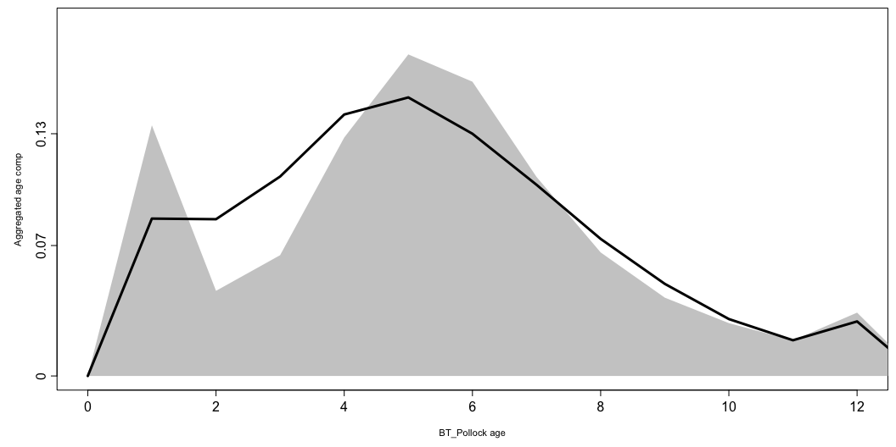

Slide 35
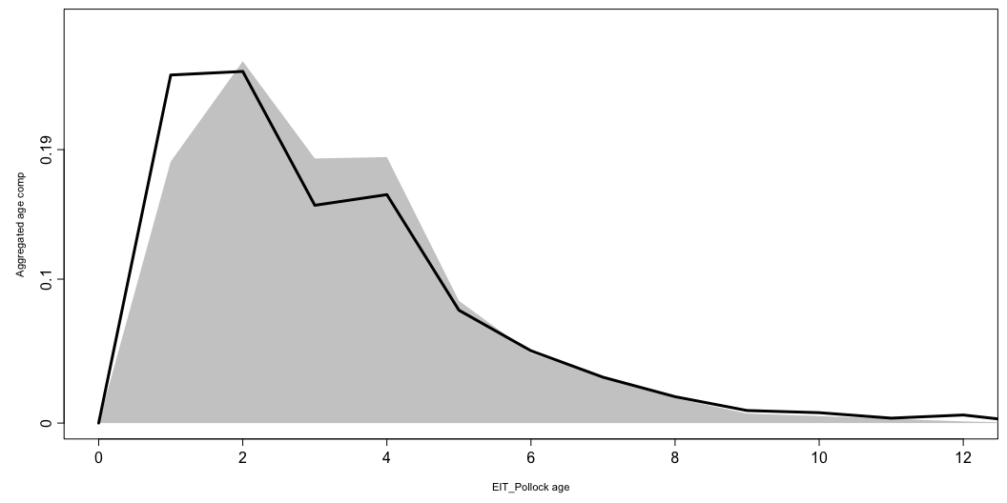

Slide 36
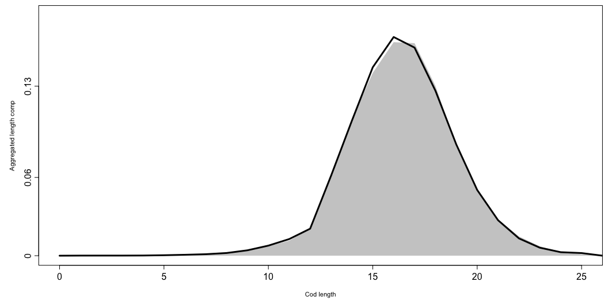

Slide 37
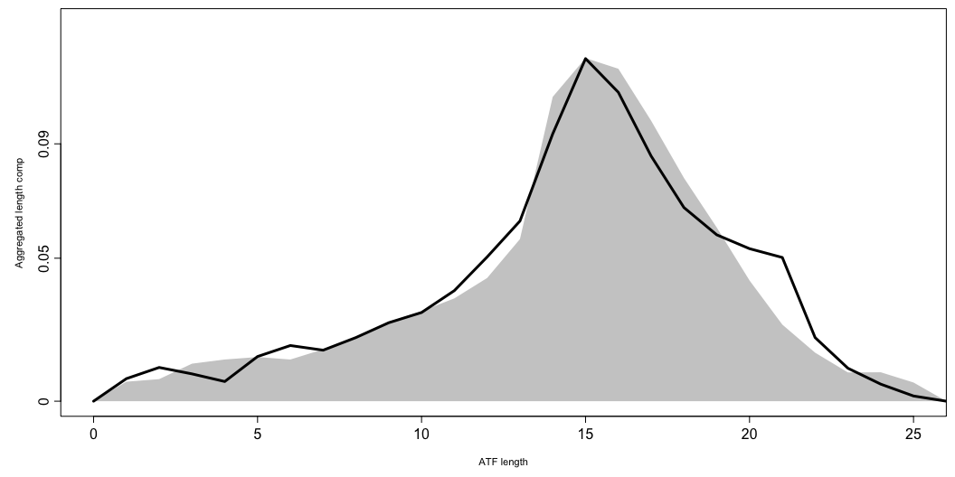

Slide 38
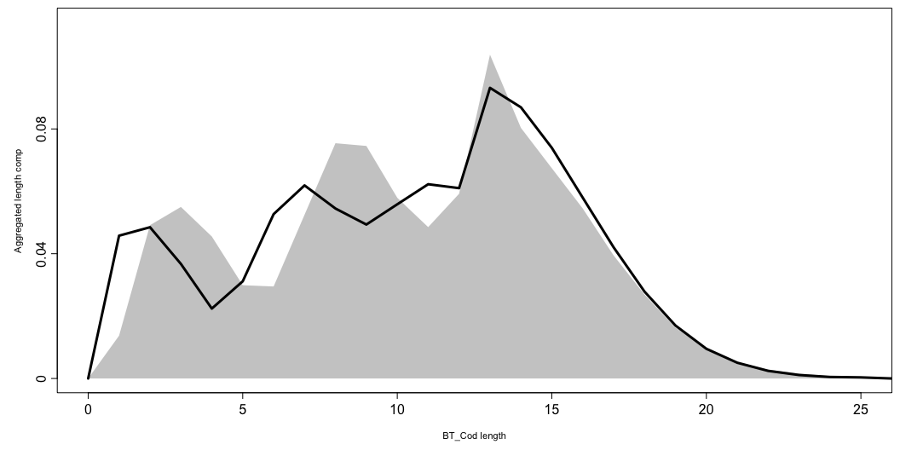

Slide 39
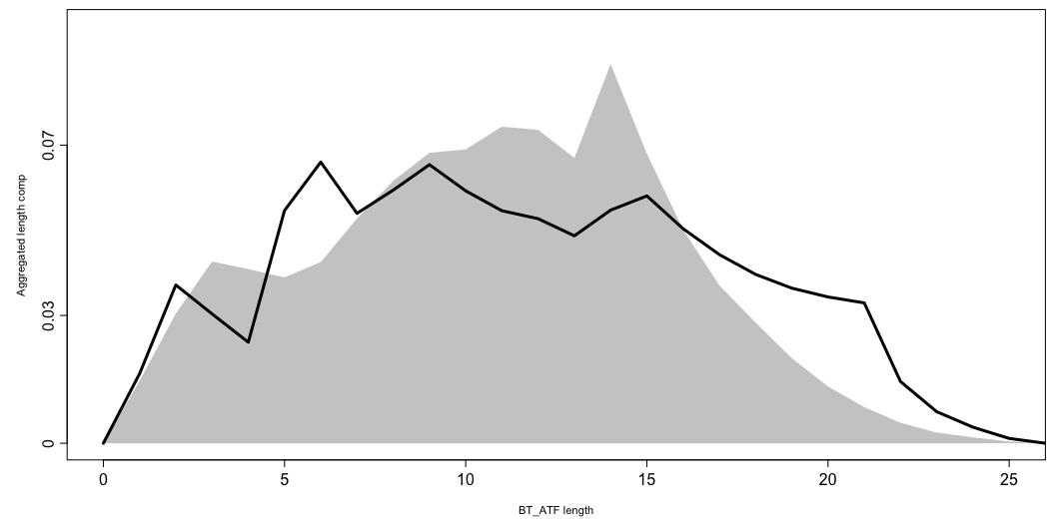

Slide 40
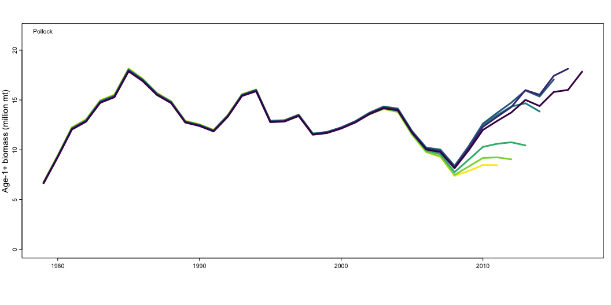
Retrospectives
retro <- retrospective(mymodel, peels = 6) plot_biomass(retro$Rceattle_list, species = 1)

Slide 41
MSE
# ?run_mse for more options mse <- run_mse( om = mymodel, em = mymodel_tier3, nsim = 1, simulate_data = TRUE, sample_rec = FALSE)

Slide 42
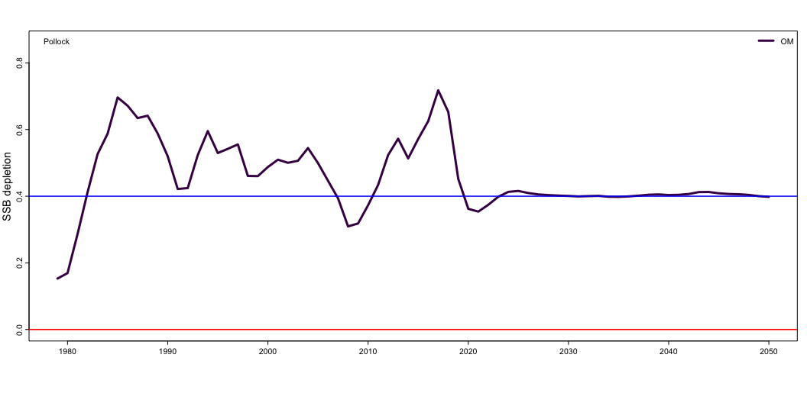
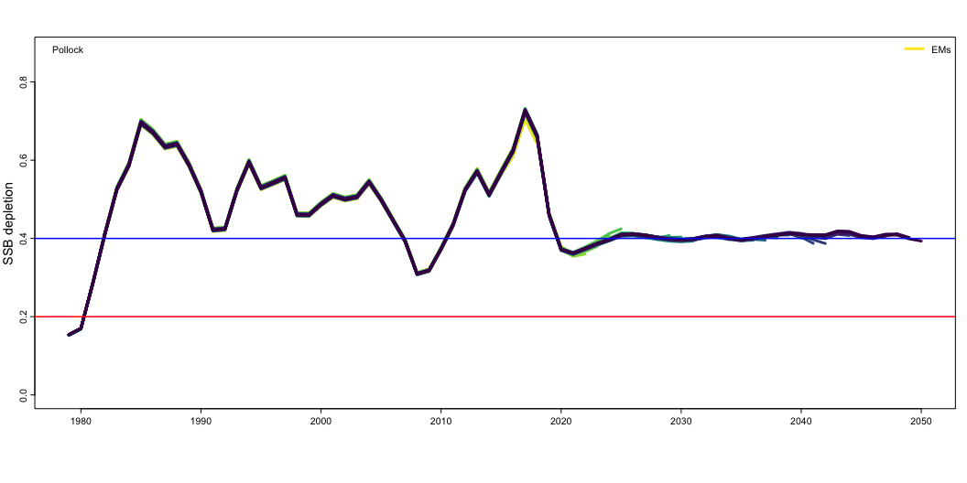
plot_depletionSSB(mse$Sim_1$OM, species = 1, model_names = "OM")
plot_depletionSSB(mse$Sim_1$EM, species = 1, model_names = "EMs")

Slide 43
MCMC with tmbstan
## Run in parallel library(tmbstan) warmup = 6000 thin = 1 iter = 6000 cores <- 3 options(mc.cores = cores) fit <- tmbstan(mymodel$obj, init = mymodel$opt$par, # Start from MLE chains=cores, open_progress=FALSE, warmup = warmup, thin = thin, iter = iter * thin + warmup, control = list(max_treedepth = 14)) ## To explore the fit use shinystan library(shinystan) launch_shinystan(fit)

